Slide 1
DA103.C (Monday)
Feel free to add comments. To use the slides, create a copy (file -> make a copy)

Slide 2

Today's Agenda
Introductions
5 min
The Case
5 min
Translating business questions into SQL
10 min
Exploring new tables
10 min
Aggregation & GROUP BY
25 min
Questions & Wrap-up
5 min
Notes:
Agenda slide: Agenda is optional, however... Depending on the lesson structure, type or topic, providing an agenda is often a great way to help students understand what to expect and how learning will take place during your lesson.

Slide 3

Motivational reminder: Our cavemen brain did not evolve naturally to program computers. You learn to program, and there will be moments of struggle.
This is normal. Don’t get discouraged. Commit to investing 15+ hours per week for a few months, you will amaze yourself at how much you have learned.
Notes:
Student Q&A slide: Provide students with instructions outlining how they can submit / ask questions at the beginning of the session (e.g., Mentimeter or Slido). (See Lesson Intro slide) Check the platform you are using to view student questions and answer some of them before the lesson is over. If you run out of time, tell students how the remaining questions will be addressed.

Slide 4




DA103 Business Cases
Week 1
Week 2
Week 3
Week 4
Today’s topic: Helping Instagram grow

Slide 5
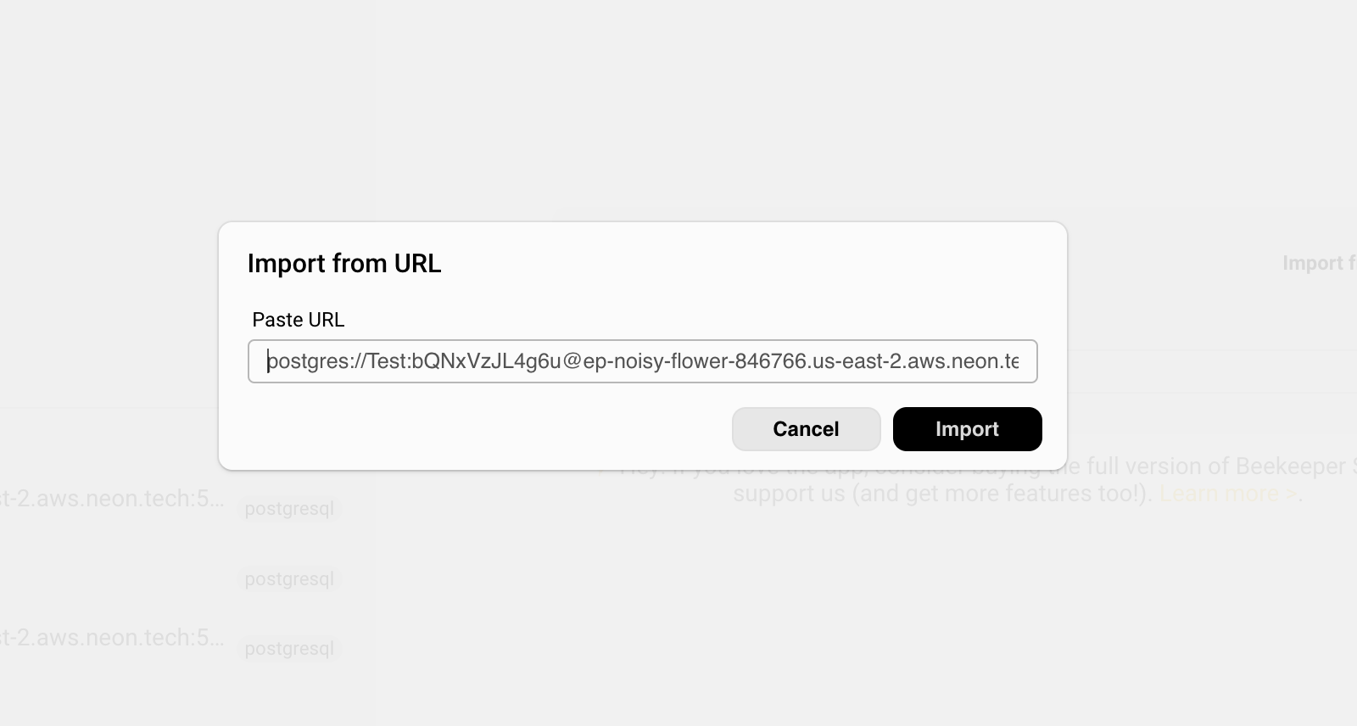
Connect to the Meta Revenue database
How to pull data from the meta_revenue table
Connect with Beekeeper studio
Link to connect to the dataset: Link
The Meta Revenue table link can be found in the speaker notes to connect to meta_revenue
Notes:
Link for dataset: https://www.notion.so/masterschool/Meta-Revenue-Dataset-DA103-2-3ed770c8059f4352af1fc280b6cd223a

Slide 6
Business Context: How does Meta make money?

Slide 7

Meta is the parent company of Facebook and Instagram. They make money by selling ads.
Meta knows a lot about you, and uses this to match advertisers (say Nike) to show the right ad (NBA playoff Jerseys) to the right person (someone passionate about basketball).
Ads can be Display (pictures) or Video ads provided by the advertiser.

Slide 8

Meta makes $100+ billion dollars a year, using the data it has to place relevant ads in front of its billions of users
Whether you scroll by the ad, or interact with the ad, the advertiser pays Meta. The goal for advertisers is usually to generate “conversions” with their ads. That means you signed-up for the advertised event, or bought something on the website after seeing the ad.

Slide 9

Like any corporation, Meta looks to hire more people into areas that are doing well
Typically this means either businesses that are big and profitable, or growing rapidly. This allows you to get more smart people growing something that works. If there’s a ton of revenue in one product area, that likely means you want a lot more people there - so that’s what we’re looking at today!

Slide 10
The Case: Helping Instagram grow

Slide 11


This week you are:
Financial Analyst at Meta Jan Maas
From Amsterdam, but has been living in Dublin for 3 years
Will ride a bicycle through a tornado if necessary
Doesn’t know why he hasn’t deleted his Facebook
Loves techno even more than bicycles
Notes:
Lesson Intro Slide: 1. Welcome: Hello and welcome to [Lesson Title], I'm [name] and today [other instructors] will be helping us learn as well! 2. Topic Intro: Today we will be learning about [topic] 3. Topic Importance: [Topic] is important for us to know as [web developers / data analysts] because [reason] 4. How to Ask Questions: Use the [Slide / Mentimeter] link to submit any questions you have during the lesson. I will stop in between topics to answer some of them as we go. If your questions are not answered during the lesson, don't worry! They will be answered after the lesson [how you will provide responses to unanswered questions]

Slide 12

Meet your Manager:
Senior Director, Sales Finance Humberto Ruiz
Will weave “his” football team Real Madrid into every conversation
Did not actually grow up in Madrid
Still uses Facebook
Is very annoyed that this box is cutting off his perfect hair on the photo
Notes:
Lesson Intro Slide: 1. Welcome: Hello and welcome to [Lesson Title], I'm [name] and today [other instructors] will be helping us learn as well! 2. Topic Intro: Today we will be learning about [topic] 3. Topic Importance: [Topic] is important for us to know as [web developers / data analysts] because [reason] 4. How to Ask Questions: Use the [Slide / Mentimeter] link to submit any questions you have during the lesson. I will stop in between topics to answer some of them as we go. If your questions are not answered during the lesson, don't worry! They will be answered after the lesson [how you will provide responses to unanswered questions]

Slide 13
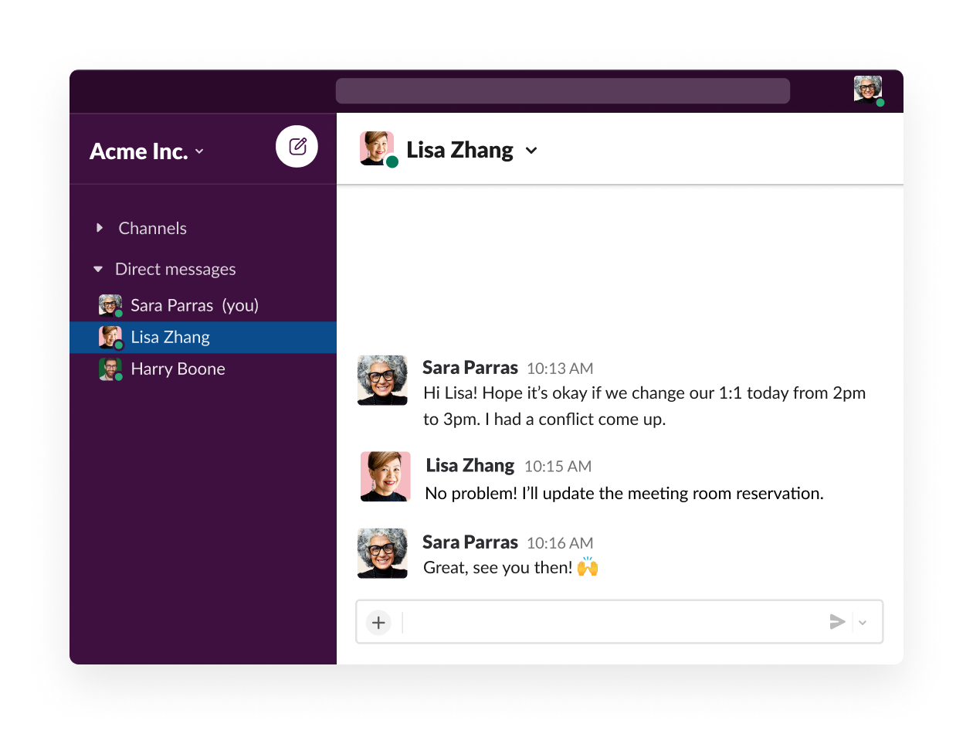


Business Question
What are reasons to invest more people in a team?
1. What are the reasons to hire more people in a sales team?
Meta Platforms
Humberto Ruiz
Jan Maas (You)
Humberto Ruiz
Hi Jan, Hope you had a great weekend! We have the big meeting coming up with Cecilia (the VP of Sales) to decide on which sales teams should hire more people in order for us to grow the business. We will need your help on this.
2. What are data points we can find to validate this?

Slide 14
Business Question
What are reasons to invest more people in a team?
1. What are the reasons to hire more people in a sales team?
Meta Platforms
Humberto Ruiz
• A sales team is growing rapidly • Every employee in the team generates a high amount of revenue
Jan Maas (You)
Humberto Ruiz
Hi Jan, Hope you had a great weekend! We have the big meeting coming up with Cecilia (the VP of Sales) to decide on which sales teams should hire more people in order for us to grow the business. We will need your help on this.
2. What are data points we can find to validate this?
• Revenue growth (e.g. Year-over-year) • Average revenue per employee compared against the company average

Slide 15
Business Question
In which area should we increase hiring?
What data can we look at to provide a recommendation?
Meta Platforms
Humberto Ruiz
Hi Jan, Hope you had a great weekend! We have the big meeting coming up with Cecilia (the VP of Sales) to decide on which sales teams should hire more people in order for us to grow the business. We will need your help on this. Facebook historically made more money for us than Instagram, so we likely want to hire more employees there. Hence, we need to understand how the revenue compares between Facebook and Instagram per year.
We want to look at historical data and patterns here, to get a deep understanding of what’s happening in the business. By understanding historical trends, we can make an estimated guess of the future, and help Meta’s leadership invest in growing areas.
Jan Maas (You)
Humberto Ruiz

Slide 16
Some mor
You may have noticed that these questions are not directly related to SQL
Humberto’s question was: “We need to understand how the revenue compares between Facebook and Instagram per year. ”
We have to translate this business question to figure out what SQL code we would need to write

Slide 17
Translating business questions into SQL

Slide 18
Translating business questions into SQL
You may have noticed that these questions are not directly related to SQL
Humberto’s question was: “We need to understand how the revenue compares between Facebook and Instagram per year. ”
We have to translate this business question to figure out what SQL code we would need to write

Slide 19
Translating business questions into SQL
You can break down any request by asking yourself a few questions
1
What is the desired result you would like to achieve? Single number? List? Table?
2
What data do you need to use to achieve this result? In which table is this data stored?
3
What columns from those tables do you need to show in your result?
4
If you are aggregating data, what function do we need to apply to our columns?
5
What columns do you need to filter the data correctly? What conditions do you need to use?

Slide 20
Translating business questions into SQL
Let’s break down Humberto’s question!
Desired result A table that summarizes the revenue per platform and year
Humberto’s question was: “The first thing we need to understand is how the revenue compares between Facebook and Instagram, historically and for the last year.”
1
Stored where? Revenue data stored in meta_revenue
2
Which columns? We need the following information: year, platform, and revenue
3
Which functions? We may need to sum up the total revenue per year
4
5
What filters? Hypothetical: what if we only needed data for last year (2022)?

Slide 21
Jan’s SQL Tips: Exploring new tables

Slide 22
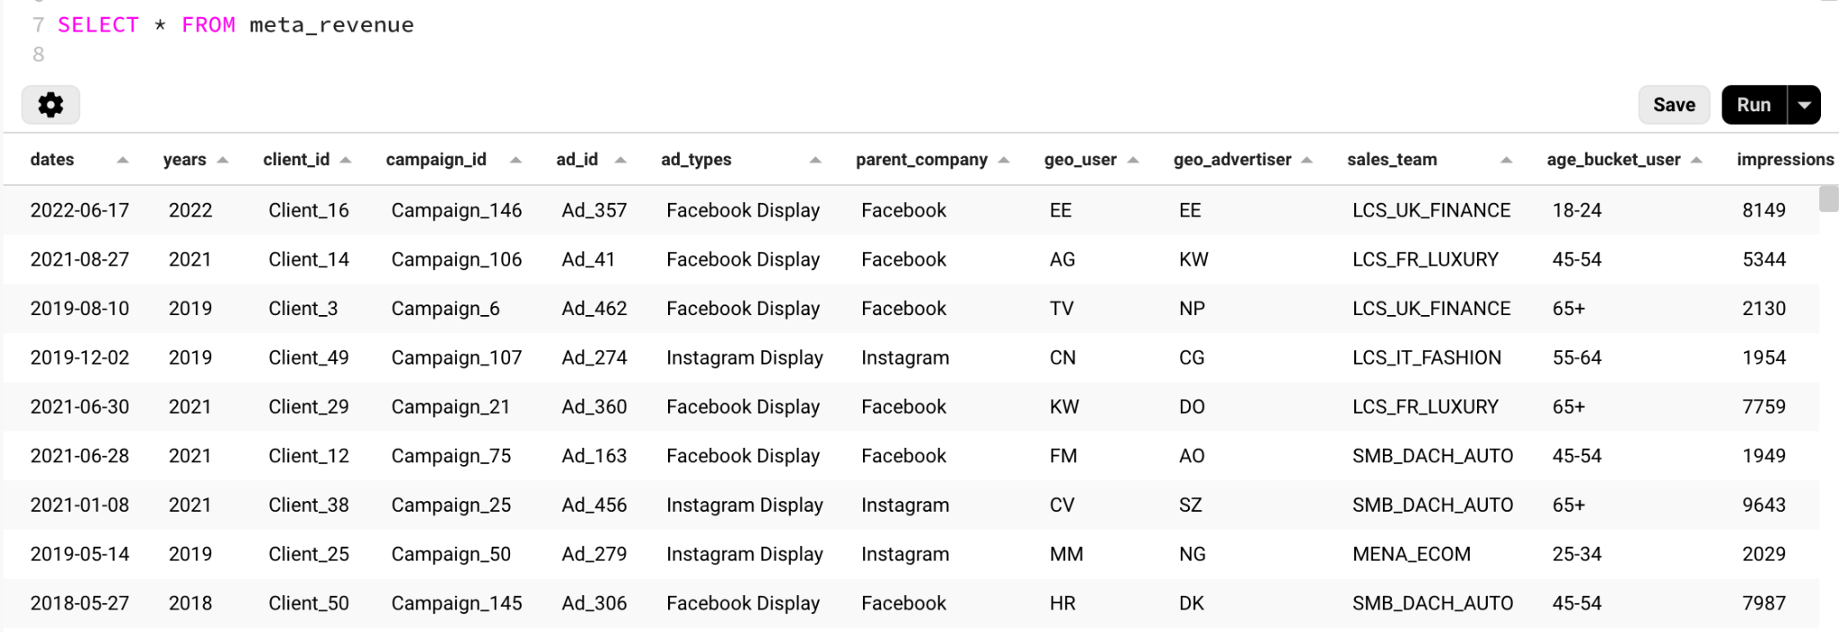

When exposed to a new table, always explore to see what’s in there first.
Pro tip: Start with SELECT * is a great way to explore the data in small tables before running further queries.
Notes:
Learning check slide: End of Lesson Check for Understanding (or Exit Ticket) Check for Understanding A short task (1-3 questions, 1-5 minutes in duration) that all students complete to measure progress toward or mastery of stated lesson objective was achieved Exit Ticket A (single) prompt or question that takes a short time for students to complete at the end of a lesson. The prompt should require students to synthesize of the lesson content and / or require some application of what was learned in the lesson.

Slide 23
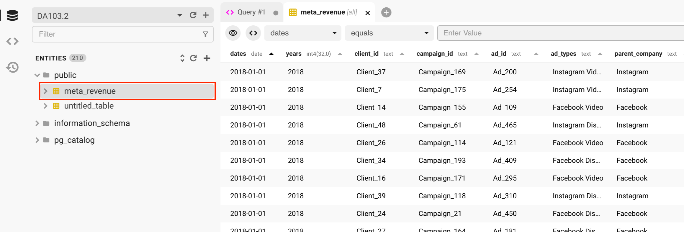
Another way is by double-clicking on the table name which opens a preview
This will imitate the SELECT * query for a small number of rows
Notes:
Learning check slide: End of Lesson Check for Understanding (or Exit Ticket) Check for Understanding A short task (1-3 questions, 1-5 minutes in duration) that all students complete to measure progress toward or mastery of stated lesson objective was achieved Exit Ticket A (single) prompt or question that takes a short time for students to complete at the end of a lesson. The prompt should require students to synthesize of the lesson content and / or require some application of what was learned in the lesson.

Slide 24
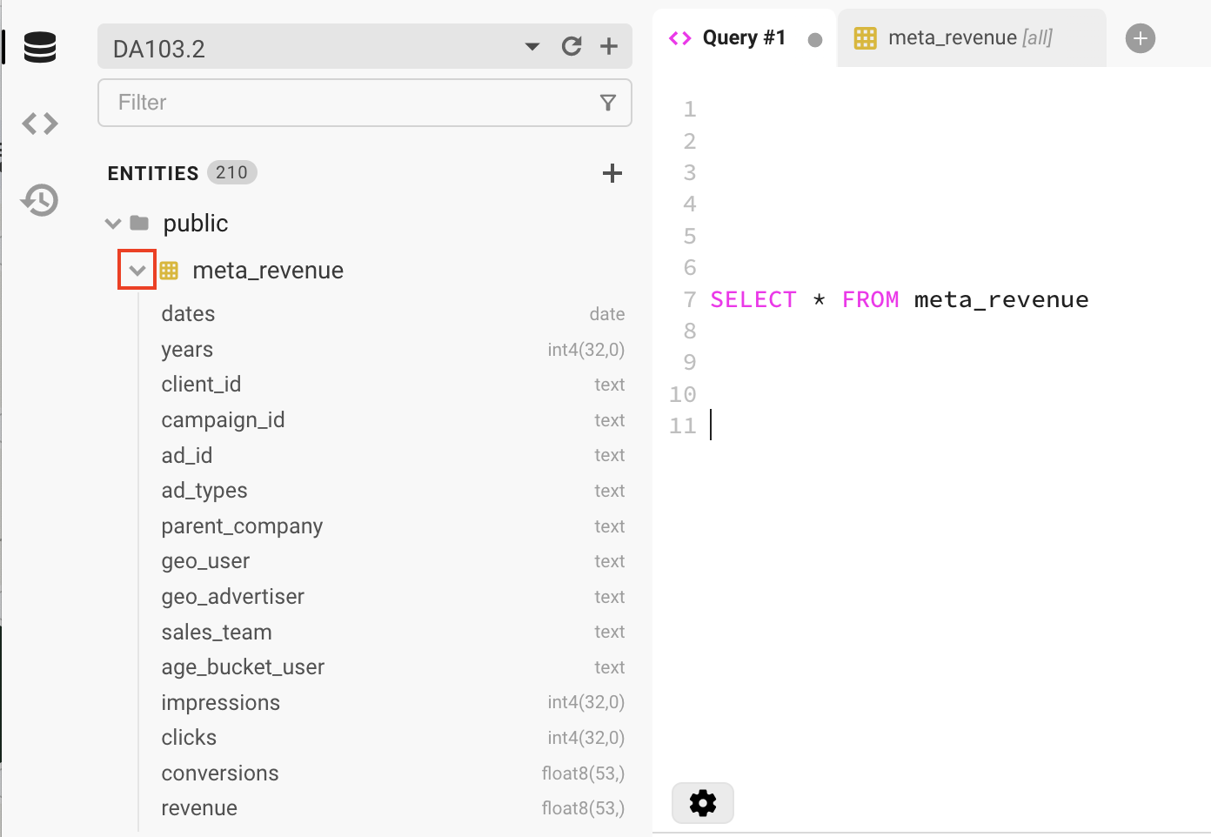
Finally, you can also look at the column overview which shows you the data type
Just click the down arrow in Beekeeper Studio.
It easily allows you to see each column in the table, and identify the things you’re looking for! This is great to identify the exact spelling (is it called “sales_team” or “salesteam” in the table?).
Notes:
Learning check slide: End of Lesson Check for Understanding (or Exit Ticket) Check for Understanding A short task (1-3 questions, 1-5 minutes in duration) that all students complete to measure progress toward or mastery of stated lesson objective was achieved Exit Ticket A (single) prompt or question that takes a short time for students to complete at the end of a lesson. The prompt should require students to synthesize of the lesson content and / or require some application of what was learned in the lesson.

Slide 25
Question for the class!
Together we’re analyzing business at very senior level (“how did the whole business do in 2022”, or “how do all teams assigned to large customers perform?” Which columns do you think will be relevant?
Notes:
Learning check slide: End of Lesson Check for Understanding (or Exit Ticket) Check for Understanding A short task (1-3 questions, 1-5 minutes in duration) that all students complete to measure progress toward or mastery of stated lesson objective was achieved Exit Ticket A (single) prompt or question that takes a short time for students to complete at the end of a lesson. The prompt should require students to synthesize of the lesson content and / or require some application of what was learned in the lesson.

Slide 26
Jan’s SQL Basics: Aggregating data

Slide 27
How to aggregate data with SQL
Like in Pivot tables in Google Sheets and Excel, you can aggregate data in different ways:
Aggregation | Explanation
SUM(<column_name>) | calculates the sum of values
MAX(<column_name>) | gets the maximum value in a set of values
MIN(<column_name>) | gets the minimum value in a set of values
AVG(<column_name>) | calculates the average of a set of values
COUNT(<column_name>) | counts rows in a specified table or view
COUNT(DISTINCT <column_name>) | counts the number of unique values
Note: all mathematical symbols (+, -, *, /) can be used to combine columns as well!
Notes:
Learning check slide: End of Lesson Check for Understanding (or Exit Ticket) Check for Understanding A short task (1-3 questions, 1-5 minutes in duration) that all students complete to measure progress toward or mastery of stated lesson objective was achieved Exit Ticket A (single) prompt or question that takes a short time for students to complete at the end of a lesson. The prompt should require students to synthesize of the lesson content and / or require some application of what was learned in the lesson.

Slide 28
Aggregation functions can be used to summarise data and find trends
The first thing Humberto said is that Facebook generated more revenue historically. Is that true? The data in our table is per day, so we would need to SUM the data (like a pivot table).
Facebook revenue: SELECT SUM(revenue) as total_revenue
FROM meta_revenue
WHERE parent_company = ‘Facebook’ ;
Instagram revenue: SELECT SUM(revenue) as total_revenue
FROM meta_revenue
WHERE parent_company = Instagram’ ;
Pro tip: Think of using an aggregation function in Excel or Google Sheets without a group
Notes:
Learning check slide: End of Lesson Check for Understanding (or Exit Ticket) Check for Understanding A short task (1-3 questions, 1-5 minutes in duration) that all students complete to measure progress toward or mastery of stated lesson objective was achieved Exit Ticket A (single) prompt or question that takes a short time for students to complete at the end of a lesson. The prompt should require students to synthesize of the lesson content and / or require some application of what was learned in the lesson.

Slide 29

How can we show the output in one query?
Humberto wants to see a breakdown in one overview to see the revenue for each, rather than the output in two queries. How can you do this?
Hint: How would you do this in a pivot table in Google Sheets or Excel?
Notes:
Learning check slide: End of Lesson Check for Understanding (or Exit Ticket) Check for Understanding A short task (1-3 questions, 1-5 minutes in duration) that all students complete to measure progress toward or mastery of stated lesson objective was achieved Exit Ticket A (single) prompt or question that takes a short time for students to complete at the end of a lesson. The prompt should require students to synthesize of the lesson content and / or require some application of what was learned in the lesson.

Slide 30
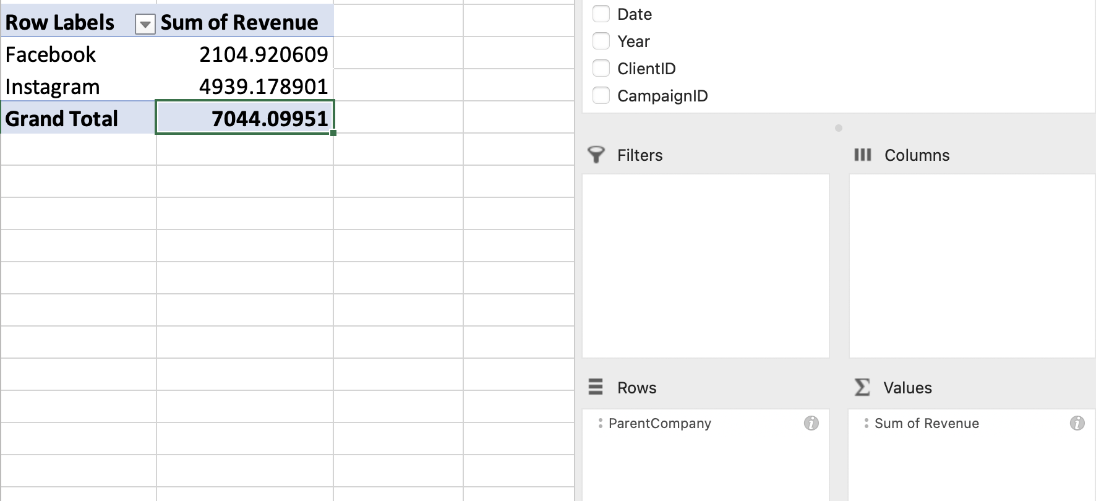
In Excel and Google Sheets, you would make a pivot table for this!
Excel comparison
This functionality may sound familiar if you have worked in Google Sheets before.
To group and aggregate your data in Excel / Google Sheets, you can use pivot tables
Notes:
Learning check slide: End of Lesson Check for Understanding (or Exit Ticket) Check for Understanding A short task (1-3 questions, 1-5 minutes in duration) that all students complete to measure progress toward or mastery of stated lesson objective was achieved Exit Ticket A (single) prompt or question that takes a short time for students to complete at the end of a lesson. The prompt should require students to synthesize of the lesson content and / or require some application of what was learned in the lesson.

Slide 31
Aggregating data with a group to include additional information
To initiate the pivot table functionality in SQL, we write GROUP BY under the FROM and WHERE statement SELECT parent_company,
SUM(revenue)
FROM meta_revenue
GROUP BY parent_company;
Rule of thumb for group by
When grouping, all columns in the SELECT statement either:
(1) need an aggregation function applied or (2) should be part of the GROUP BY
Notes:
Learning check slide: End of Lesson Check for Understanding (or Exit Ticket) Check for Understanding A short task (1-3 questions, 1-5 minutes in duration) that all students complete to measure progress toward or mastery of stated lesson objective was achieved Exit Ticket A (single) prompt or question that takes a short time for students to complete at the end of a lesson. The prompt should require students to synthesize of the lesson content and / or require some application of what was learned in the lesson.

Slide 32
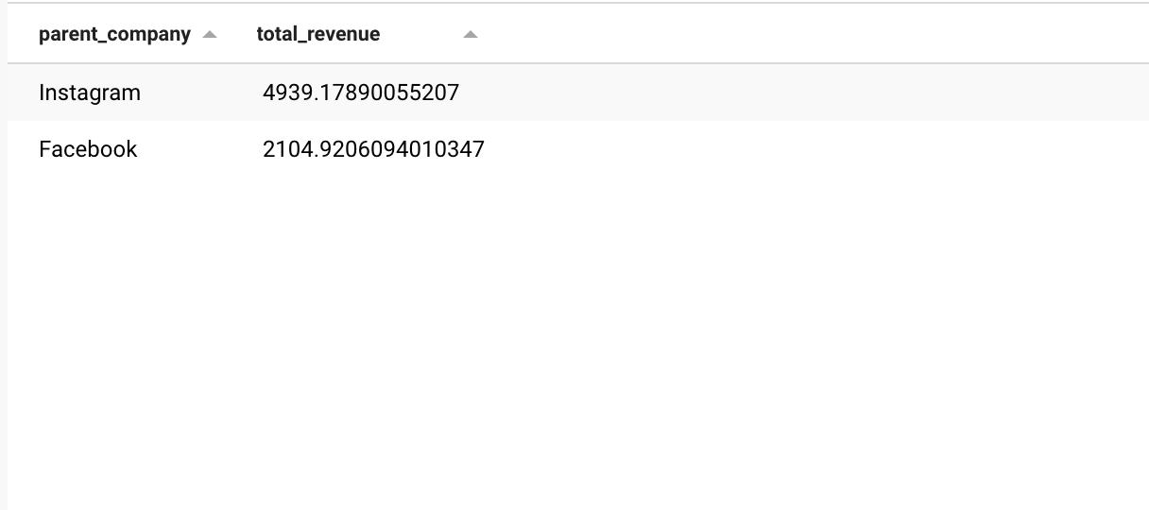
How to split out Facebook vs Instagram?
Humberto doesn’t like the output in his format. It’s not clear that we’re pulling total revenue here.
Let’s use the ALIAS function to name our function something intuitive!
SELECT parent_company,
SUM(revenue) AS total_revenue
FROM meta_revenue
GROUP BY parent_company;
You can rename any column with the AS function!
Notes:
Learning check slide: End of Lesson Check for Understanding (or Exit Ticket) Check for Understanding A short task (1-3 questions, 1-5 minutes in duration) that all students complete to measure progress toward or mastery of stated lesson objective was achieved Exit Ticket A (single) prompt or question that takes a short time for students to complete at the end of a lesson. The prompt should require students to synthesize of the lesson content and / or require some application of what was learned in the lesson.

Slide 33
Adding multiple groups to aggregate data more granular
Similarly as in Google Sheet and Excel, you can continue to add multiple groups in the query SELECT parent_company,
ad_types,
SUM(revenue)
FROM meta_revenue
GROUP BY parent_company,
ad_types;
Rule of thumb for group by
When grouping, all columns in the SELECT statement either:
(1) need an aggregation function applied or (2) should be part of the GROUP BY
Notes:
Learning check slide: End of Lesson Check for Understanding (or Exit Ticket) Check for Understanding A short task (1-3 questions, 1-5 minutes in duration) that all students complete to measure progress toward or mastery of stated lesson objective was achieved Exit Ticket A (single) prompt or question that takes a short time for students to complete at the end of a lesson. The prompt should require students to synthesize of the lesson content and / or require some application of what was learned in the lesson.

Slide 34
Let’s resolve Humberto’s request in one query!
What is the revenue of our platforms in the last years?
Humberto’s question was: “We need to understand how the revenue compares between Facebook and Instagram per year. ” Follow up business question: Based on the insights you found, where would you hire more people?

Slide 35
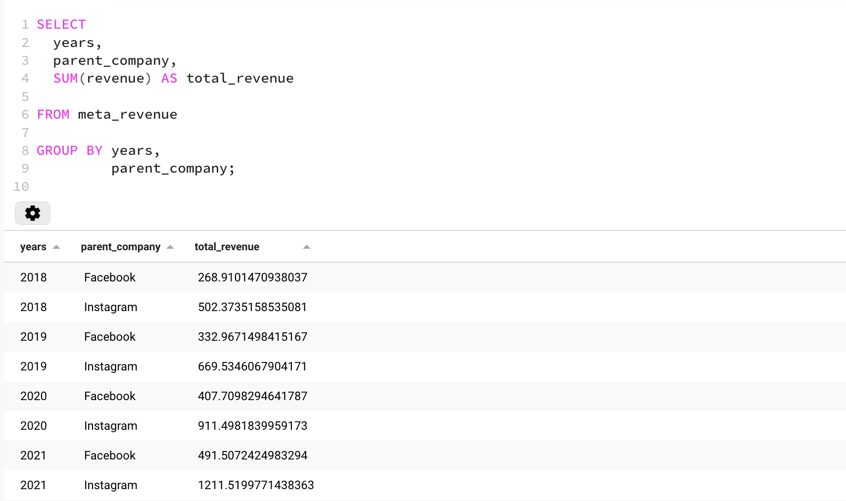
Showing how it’s done
Note the GROUP BY and the aggregation!
Humberto’s question was: “We need to understand how the revenue compares between Facebook and Instagram per year. ” Follow up business question: Based on the insights you found, where would you hire more people?

Slide 36
Business Question
In which area should we increase hiring?
We’re getting closer!
Meta Platforms
Humberto Ruiz
When you deliver an analysis that has a surprising insight, you will often get follow-up questions. When it’s possible, anticipating the follow-up question and already preparing the numbers for that will really help you stand out!
Hi Jan, This is crazy! I didn’t know that Instagram was so much bigger in revenue than Facebook. Super powerful insight. One follow-up question. Cecilia and sales leadership will not only ask about the revenue, but also the conversions and impressions for each platform. We only need this for 2022. This will help them understand the relative importance of each business, and hence where to hire in.
Jan Maas (You)
Humberto Ruiz

Slide 37
Let’s resolve Humberto’s request in one query!
What is the revenue, conversions, and impressions for 2022 per platform?
Humberto’s question was: “Cecilia and sales leadership will not only ask about the revenue, but also the conversions and impressions for each platform. We only need this for 2022.”

Slide 38
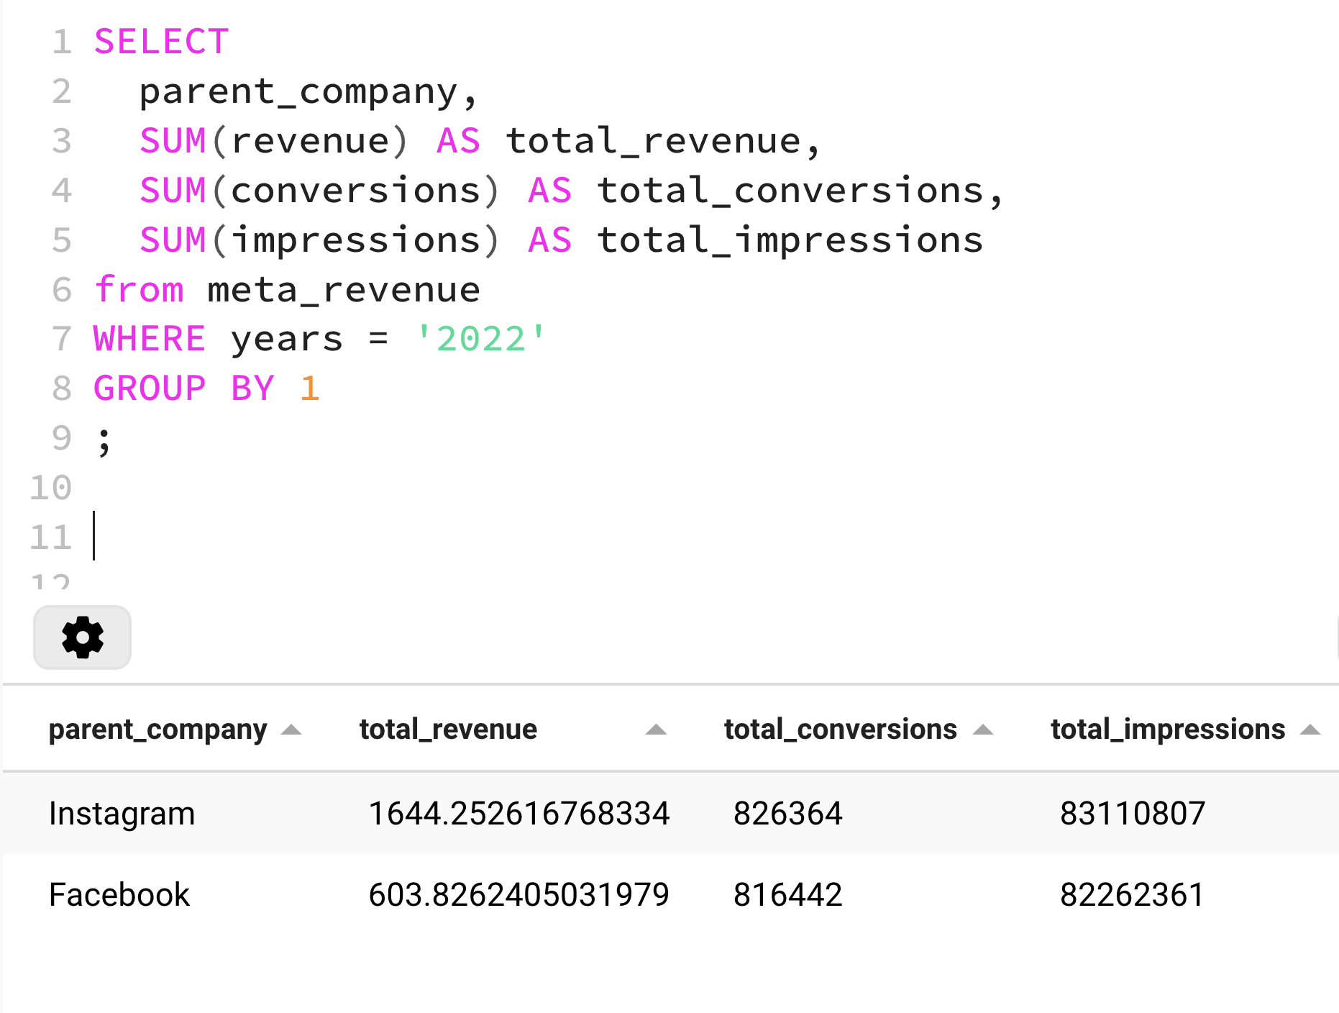
Showing how it’s done
Note writing down multiple metrics and WHERE
Humberto’s question was: “Cecilia and sales leadership will not only ask about the revenue, but also the conversions and impressions for each platform. We only need this for 2022.”

Slide 39
Business Question
In which area should we increase hiring?
Well done! Your manager has all the insights to present his proposal
Meta Platforms
Humberto Ruiz
You’ve delivered an insight that shows a pattern that changes how people think about the business. In the next session, we’ll go deeper into these elements in the inevitable follow-up questions!
Jan Maas (You)
Humberto Ruiz
Hi Jan, That’s perfect. This is a really powerful narrative, that gives us a sense how many employees we should allocate overall to Facebook and Instagram, so we can grow more effectively. Cecilia will love it. I’m expecting some follow-up questions after the meeting, will message you in the coming days! Enjoy your evening!

Slide 40

Wrap-up
Campus material is live and available 24/7.
Use Chat Bubble as much as you need!
Reach out w/ questions via Slack.
Next live session on Wednesday July 19.

Slide 41
Next up…
Week 1
Week 2
Week 3
Week 4
Wednesday’s case study: Helping Instagram grow

Slide 42
Thank You
And Keep Practicing!

